Slide 1


Slide 2
TYPING

Slide 3

What is typing?
Typing is the process of writing or inputting text by pressing keys on a typewriter, computer keyboard, cell phone, or calculator.
It can be distinguished from other means of text input, such as handwriting and speech recognition.
Text can be in the form of letters, numbers and other symbols.
The world's first typist was Lillian Sholes from Wisconsin, the daughter of Christopher Sholes, who invented the first practical typewriter.

Slide 4
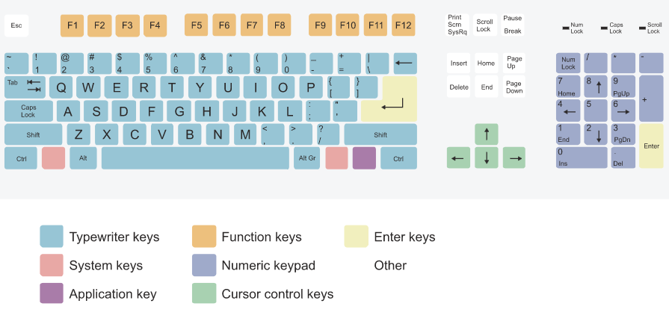
Keys on keyboard

Slide 5

TYPING TECHNIQUE
For more information visit: https://en.wikipedia.org/wiki/Typing

Slide 6
Touch Typing
Touch typing also involves the use of the home row method, where typists rest their wrist down, rather than lifting up and typing.
Many touch typists also use keyboard shortcuts when typing on a computer.
This allows them to edit their document without having to take their hands off the keyboard to use a mouse.

Slide 7
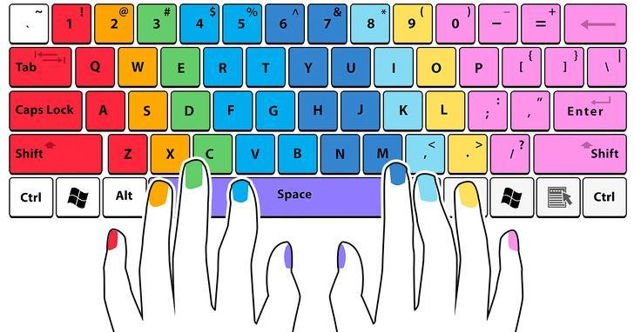
Learn touch typing through color code

Slide 8
Hunt and peck
Hunt and peck is a common form of typing in which the typist presses each key individually.
Instead of relying on the memorized position of keys, the typist must find each key by sight.

Slide 9
Rules of Typing
Try to not look at the keyboard while practicing.
Know the finger positions.
Use the shift keys.
Be Patient.

Slide 10
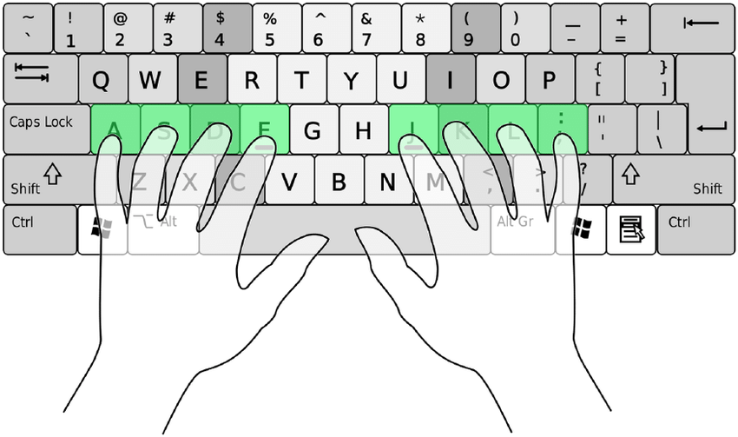
Correct positions of hands on keyboard

Slide 11
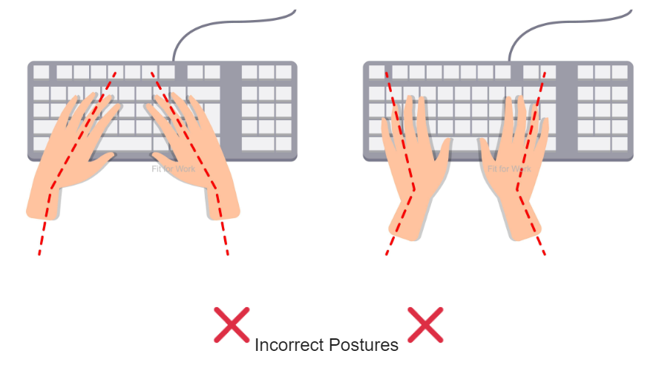
Incorrect positions of hands on keyboard

Slide 12
Thankyou ☺

